Slide 1
Different types of Databases
28

Slide 2
What is Data?
Data is a collection of a distinct small unit of information. It can be used in a variety of forms like text, number, media, bytes etc.

Slide 3
What is Database?
Collection of inter-related data
Organize data into table, schema, views etc.
Large amount of information by storing, retrieving and managing data.

Slide 4

Contents
Introduction to database in relation to Grid and Cloud.
Introduction to pluggable database
Introduction to pluggable database with different database architecture
Introduction to Autonomous database
Intelligent Technologies
Selection of Autonomous Database
Introduction to different types of databases, Object Oriented Database,
Introduction to Temporal Database, Mobile Database
Introduction to NOSQL, Cloud Database

Slide 5
What is Grid-Database
A collection of one or more databases logically interrelated (distributed over a grid environment) which can also be heterogeneous and contain replica, accessible through a Grid-DBMS front end. It represents an extension and a virtualization of the Database concept in a grid environment.

Slide 6
A Data Grid is a system composed of multiple servers that work together to manage information and related operations - such as computations - in a distributed environment.
Grid is basically group of similar components working towards a common task.

Slide 7
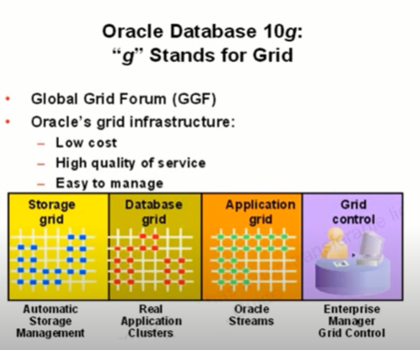

Slide 8
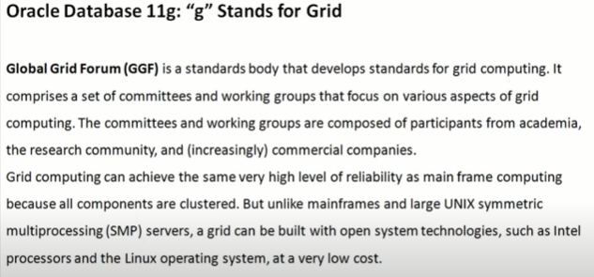

Slide 9
How Does a Data Grid work?
A data grid works by running specialized software on every computer that participates in the grid. The software acts as the manager of the entire system and coordinates various tasks across the grid. Specifically, the software assigns subtasks to each computer so they can work simultaneously on their respective subtasks. After the completion of subtasks, the outputs are gathered and aggregated to complete a larger-scale task. The software lets each computer communicate over the network with the other computers so they can share information on what portion of the subtasks each computer is running, and how to consolidate and deliver outputs.

Slide 10
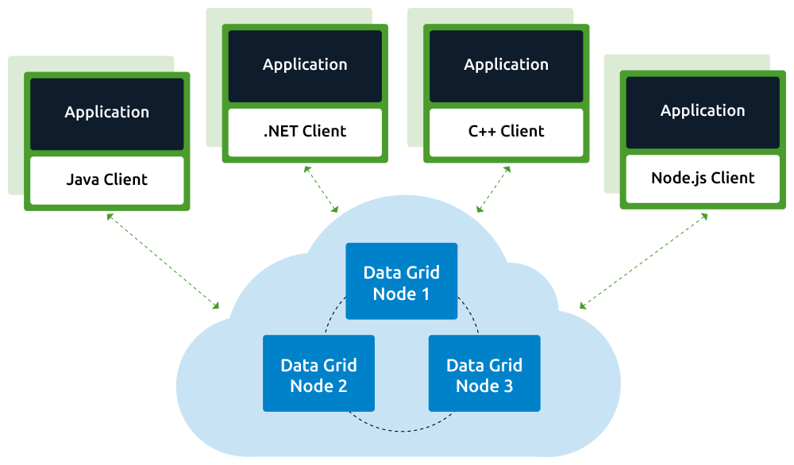
How Does a Data Grid work?

Slide 11
Introduction to pluggable database
A PDB is a user-created entity that contains the data and code required for a specific set of features. For example, a PDB can support a specific application, such as a human resources or sales application. No PDBs exist at creation of the CDB. You add PDBs based on your business requirements.

Slide 12
The multi-tenant architecture enables an Oracle database to function as a multitenant container database (CDB). A CDB includes zero, one, or many customer-created pluggable databases (PDBs).

Slide 13
Besides the fact that a CDB can contain one or more PDBs, the major difference between the two is that the former contains little or no user data; user data resides in the PDBs. PDBs can be created by. Copying files from the seed and then associating the new files with the PDB being created.

Slide 14
Introduction to Autonomous database
An autonomous database is a cloud database that uses machine learning to automate database tuning, security, backups, updates, and other routine management tasks traditionally performed by DBAs. Unlike a conventional database, an autonomous database performs all these tasks and more without human intervention.

Slide 15
Components of Autonomous database
An autonomous database consists of two key elements that align with workload types.
A data warehouse performs numerous functions related to business intelligence activities, and uses data that’s been prepared in advance for analysis. The data warehouse environment also manages all database lifecycle operations, can perform query scans on millions of rows, is scalable to business needs, and can be deployed in a matter of seconds.
Transaction processing enables time-based transactional processes such as real-time analytics, personalization, and fraud detection. Transaction processing typically involves a very small number of records, is based on predefined operations, and allows for simple application development and deployment.

Slide 16
Autonomous database working
An autonomous database leverages AI and machine learning to provide full, end-to-end automation for provisioning, security, updates, availability, performance, change management, and error prevention.
In this respect, an autonomous database has specific characteristics.
It is self-driving
All database and infrastructure management, monitoring, and tuning processes are automated. DBAs can now focus on more important tasks, including data aggregation, modeling, processing, governance strategies, and helping developers use in-database features and functions with minimal changes to their application code.
It is self-securing
Built-in capabilities protect against both external attacks and malicious internal users. This helps eliminate concerns about cyberattacks on unpatched or unencrypted databases.
It is self-repairing
This can prevent downtime, including unplanned maintenance. An autonomous database can require fewer than 2.5 minutes of downtime per month, including patching.

Slide 17
Selection of Autonomous Database
Autonomous databases offer many benefits. When you're ready to evaluate the offerings available to your organization, look for the following key features.
Auto-Provisioning
Automatically deploys mission-critical databases that are fault-tolerant and highly available. Enables seamless scale-out, protection in case of a server failure, and allows updates to be applied in a rolling fashion while apps continue to run.
Auto-Configuration
Automatically configures the database to optimize for specific workloads. Everything from the memory configuration, the data formats, and access structures are optimized to improve performance. Customers can simply load data and go.
Auto-Indexing
Automatically monitors workload and detects missing indexes that could accelerate applications. It validates each index to ensure its benefit before implementing it and uses machine learning to learn from its own mistakes.
Auto-Scaling
Automatically scales compute resources when needed by workload. All scaling occurs online while the application continuously runs. Enables true pay per use.

Slide 18
Selection of Autonomous Database
Automated Data Protection
Automatically protects sensitive and regulated data in the database, all via a unified management console. Assesses the security of your configuration, users, sensitive data, and unusual database activities.
Automated Security
Automatic encryption for the entire database, backups, and all network connections. No access to OS or admin privileges prevents phishing attacks. Protects the system from both cloud operations and any malicious internal users.
Auto-Backups
Automatic daily backup of database or on-demand. Restores or recovers a database to any point in time you specify in the last 60 days.
Auto-Patching
Automatically patches or upgrades with zero downtime. Applications continue to run as patching occurs in a round-robin fashion across cluster nodes or servers.
Automated Detection and Resolution
Using pattern recognition, hardware failures are automatically predicted without long timeouts. IOs are immediately redirected around unhealthy devices to avoid database hangs. Continuous monitoring for each database automatically generates service requests for any deviation.
Automatic Failover
Automatic failover with zero-data loss to standby. It’s completely transparent to end-user applications. Provides 99.995% SLA.

Slide 19
Intelligent Technologies
Application of scientific knowledge performing decision-making functions that would formerly have required human intervention.
There are various approach and means which use knowledge to reach concrete purpose in efficiency.

Slide 20
Types of Intelligent Technologies
Artificial Intelligence: AI refers to the techniques that allow a machine to replicate a human action. AI has been around in various forms for decades. For example, automated phone directories replaced the traditional operator who would connect callers with the department or person they were looking to speak with.
Blockchain: It is a decentralized ledger that utilizes a peer-to-peer network to provide greater transparency for transactions. First popularized in the late 2000s by the founders of Bitcoin, the technology’s use increased during the 2010s as companies looked to improve financial reporting capabilities.
Internet of Things: The Internet of Things (IoT) refers to interconnectivity among assets and devices, allowing them to talk to and interact with one another.

Slide 21
Introduction to database
A database, in the most general sense, is an organized collection of data. More specifically, a database is an electronic system that allows data to be easily accessed, manipulated and updated.

Slide 22
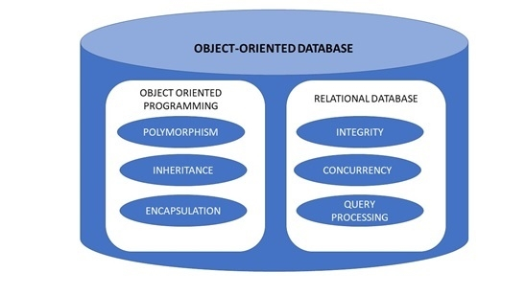
Object-Oriented Databases
An object-oriented database is a collection of object-oriented programming and relational database. There are various items which are created using object-oriented programming languages like C++, Java which can be stored in relational databases, but object-oriented databases are well-suited for those items.
An object-oriented database is organized around objects rather than actions, and data rather than logic. For example, a multimedia record in a relational database can be a definable data object, as opposed to an alphanumeric value.

Slide 23
Temporal Database
A Temporal Database is a database with built-in support for handling time sensitive data. Usually, databases store information only about current state, and not about past states. For example in a employee database if the address or salary of a particular person changes, the database gets updated, the old value is no longer there. However for many applications, it is important to maintain the past or historical values and the time at which the data was updated. That is, the knowledge of evolution is required. That is where temporal databases are useful. It stores information about the past, present and future. Any data that is time dependent is called the temporal data and these are stored in temporal databases.

Slide 24
Mobile Database
Mobile Database is a database that is transportable, portable, and physically separate or detached from the corporate database server but has the capability to communicate with those servers from remote sites allowing the sharing of various kinds of data.
With mobile databases, users have access to corporate data on their laptop, PDA (Personal Digital Assistant), or other Internet access device that is required for applications at remote sites.

Slide 25
The components of a mobile database environment include:
Corporate database server and DBMS that deals with and stores the corporate data and provides corporate applications
Remote database and DBMS usually manages and stores the mobile data and provides mobile applications
mobile database platform that includes a laptop, PDA, or other Internet access devices
Two-way communication links between corporate and mobile DBMS.

Slide 26
Introduction to NOSQL
NoSQL databases are different than relational databases like MQSql. In relational database you need to create the table, define schema, set the data types of fields etc before you can actually insert the data. In NoSQL you don’t have to worry about that, you can insert, update data on the fly.
One of the advantage of NoSQL database is that they are really easy to scale and they are much faster in most types of operations that we perform on database. There are certain situations where you would prefer relational database over NoSQL, however when you are dealing with huge amount of data then NoSQL database is your best choice.

Slide 27
Introduction to Cloud Database
A cloud database is a database service built and accessed through a cloud platform. It serves many of the same functions as a traditional database with the added flexibility of cloud computing. Users install software on a cloud infrastructure to implement the database.
Key features:
A database service built and accessed through a cloud platform
Enables enterprise users to host databases without buying dedicated hardware
Can be managed by the user or offered as a service and managed by a provider
Can support relational databases (including MySQL and PostgreSQL) and NoSQL databases (including MongoDB and Apache CouchDB)
Accessed through a web interface or vendor-provided API

Slide 28


